Slide 1

Practical 10

Slide 2
Joins and Views

Slide 3
Objectives
Learn how to create SQL queries that join multiple tables
Learn how to create nested SQL queries
Understand how to combine query results using set operators
Understand views

Slide 4
Joining Multiple Tables
Join: combine data from multiple database tables using foreign key references
SELECT field1, field2, ... FROM table1, table2 WHERE table1.joinfield = table2.joinfield AND search_condition(s);
If tables share field names, must prefix field in select with table name (table1.field1, table2.field1)
Join condition: part of where clause indicating how tables are related (table1.foreign_key = table2.primary key)
Search conditions can be added to join condition using AND operator

Slide 5
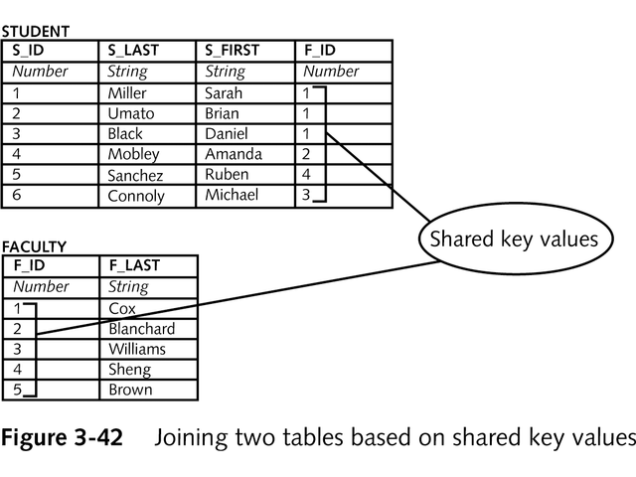
Inner Join
Join two tables based on values in one table being equal to values in another table
Also known as equality join, equijoin or natural join
Returns results only if records exist in both tables

Slide 6
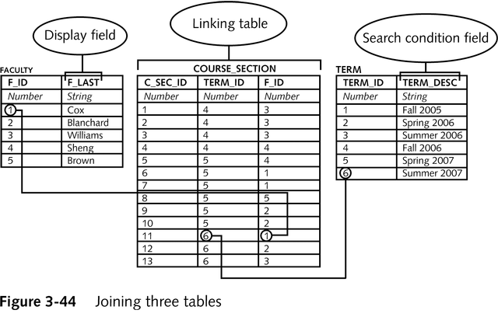
Joining Via Linking Table

Slide 7
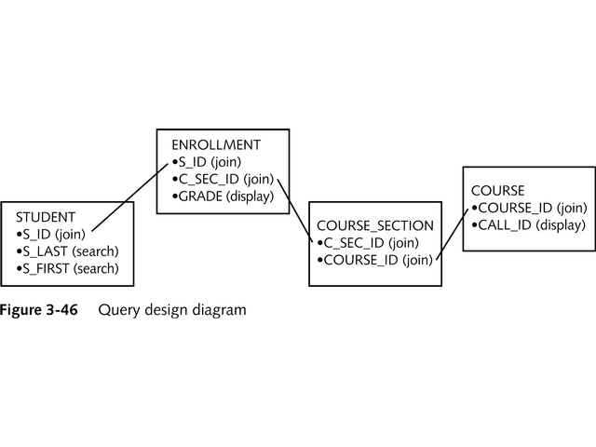
Using a Query Design Diagram
Helpful for creating complicated queries
Can use a formula to derive actual query from diagram

Slide 8
Outer Join
Returns all rows in one table and matching rows in joined table
Inner table: all rows are returned
Outer table: matching rows are returned
Outer table marked with a + in join condition
inner_table.join_field = outer_table.join_field(+)
Null values are inserted for fields in outer table that are not found

Slide 9
Self-Join
A query that joins a table to itself
Used when a table has a foreign key relationship to itself (usually parent-child relationship)
Must create a table alias and structure the query as if you are joining the table to a copy of itself
FROM table1 alias1, ...
Use alias, not table name for select and where clauses

Slide 10
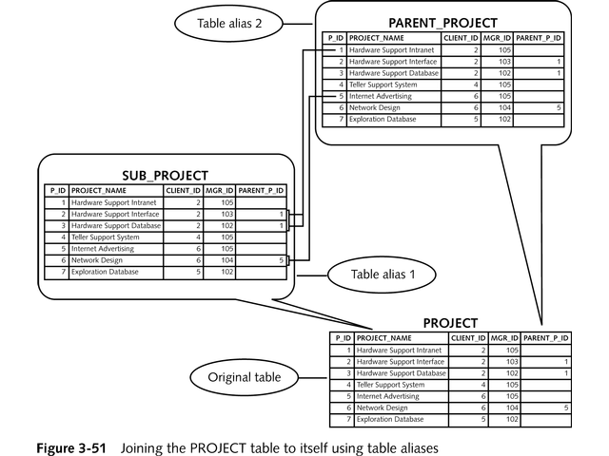
Self-Join Example

Slide 11
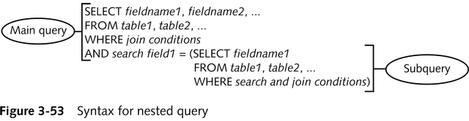
Creating Nested Queries
Used to select results based on the result of a query
Consists of a main query and one or more subqueries.
Main query: first query that appears in the SELECT command
Subquery retrieves values that the main query’s search condition must match

Slide 12
Creating Nested Queries
Nested queries can return single or multiple values
To match single values use = operator
To match multiple values use IN operator
Subqueries can be nested to more than one level (nested subqueries)
Nested subqueries are slower than joins and should be used sparingly

Slide 13
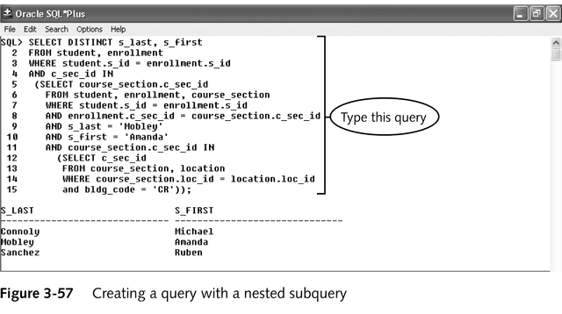
Nested Subquery Example

Slide 14
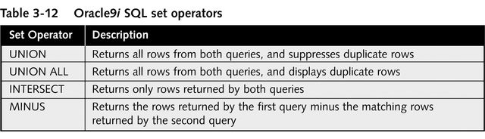
Using Set Operators To Combine Query Results
Use to select data from multiple tables not connected with foreign key relationships

Slide 15
Set Operators
query1 OPERATOR query2; (where operator is UNION, UNION ALL, INTERSECT, or MINUS)
Both queries must have same number of select fields and same data types in same order
UNION suppresses duplicate values
UNION ALL includes duplicate values
INTERSECT takes only matching fields
MINUS takes only fields in query1 not query2

Slide 16
Creating and Using Database Views
Similar to storing the result of a query in the database
Based on a source query that:
can specify a subset of a single table’s fields or records
can join multiple tables
Can be used to enforce security (user has access to view but not underlying table)

Slide 17
Creating and Using Database Views
Views can be updateable if:
SELECT clause contains only fieldnames, no functions or calculations
cannot contain the ORDER BY, DISTINCT, or GROUP BY clauses, group functions, or set operators
search condition cannot contain a nested query
Views are used like tables for selecting, inserting, updating and deleting data (only updatable views can be modified)

Slide 18
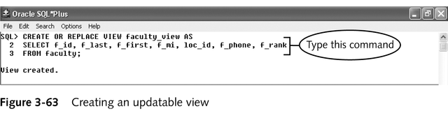
Creating and Deleting Views
CREATE OR REPLACE VIEW view_name AS source_query;
DROP VIEW viewname;

